Slide 1
Presented by S.Neelaveni Register NO:813821205035 NM mail ID:neelaveni0413@gmail.com (au813821205035) Department:Information Technology College:Saranathan college of engineering
SKIN CANCER DETECTION using CNN

Slide 2
PROJECT TITLE
Skin Cancer Detection

Slide 3


AGENDA
Introduction
Problem Statement
Project Overview
End Users
Solution and Value Proposition
Unique Features
Modelling Approach
Results
Conclusion
Future Work
3/21/2024 Annual Review

Slide 4

PROBLEM STATEMENT
To build a CNN based model which can accurately detect melanoma. Melanoma is a type of cancer that can be deadly if not detected early. It accounts for 75% of skin cancer deaths. A solution which can evaluate images and alert the dermatologists about the presence of melanoma has the potential to reduce a lot of manual effort needed in diagnosis.

Slide 5

PROJECT OVERVIEW
Build a Convolutional Neural Network (CNN) model for melanoma detection.
Utilize image processing techniques to preprocess and analyze skin images.
Implement a user-friendly interface for dermatologists to upload and analyze images.
Provide real-time alerts for potential melanoma cases.

Slide 6
WHO ARE THE END USERS?
1. Dermatologists:
- Rely on automated analysis for accurate diagnoses and streamlined workflow.
- Experience improved efficiency in melanoma detection and treatment planning.
2. Medical Professionals:
- Utilize the system for comprehensive skin cancer evaluations, enhancing treatment efficacy.
- Benefit from reliable and timely assessments, aiding in patient care and management.
3. Patients:
- Indirectly benefit from early melanoma detection, leading to improved outcomes.
- Gain reassurance from reliable diagnoses, contributing to peace of mind and well-being.

Slide 7

YOUR SOLUTION AND ITS VALUE PROPOSITION
Our solution automates melanoma detection, saving time and reducing manual effort.
Provides quick and accurate assessment of skin images.
Enables early detection, potentially saving lives.
Enhances workflow efficiency for dermatologists and medical professionals.

Slide 8

THE WOW IN YOUR SOLUTION
User-friendly interface for easy image upload and analysis.
Integration with existing healthcare systems for seamless workflow.
Real-time alerts for potential melanoma cases.
Continuously improving accuracy through machine learning.
3/21/2024 Annual Review
8

Slide 9
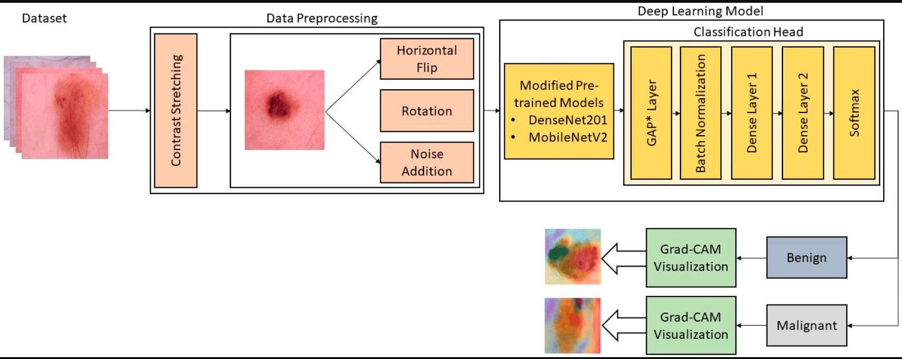
MODELLING
9

Slide 10
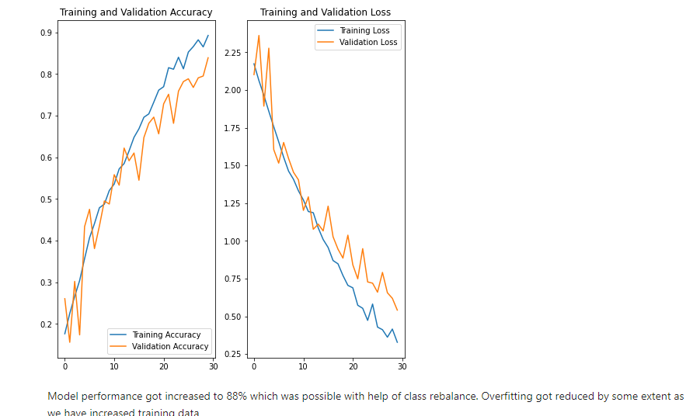
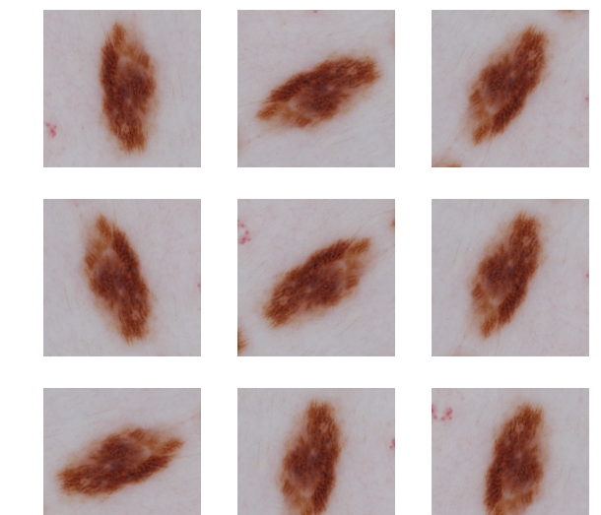
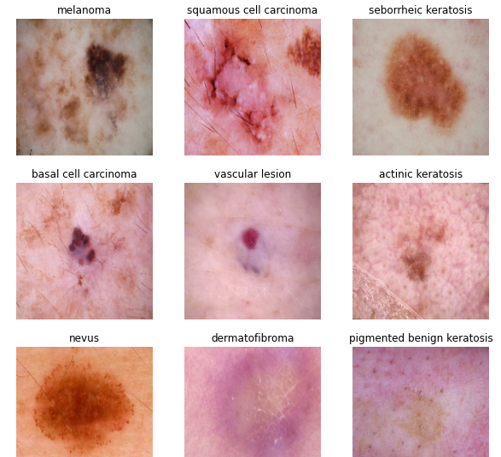
RESULTS
DEMO LINK:
https://github.com/NeelaveniSelvaraj/TNSDC-Generative-AI.git
10

